Slide 1
E-rx and Immunization(Vaccination) Portal
Guided By :-
Mr. Bharat Chaudhari
Developed By
Miss. Kinjal Jarodiya
Miss.Bhakti Govani
Miss. Komal Tripathi
Submitted To :-
Gujarat Technological Univerisity

Slide 2
Project Profile
Project title: E-rx and Immunization(Vaccination) Portal
Technology: J2EE With My SQL Server
Team Size: 3 Members
Role: Software Developer, Programmer
Internal Guide: Mr. Jay Acharya
External Guide: Mr. Bharat Chaudhari
Development Font End : J2EE
Platform: Back End : My SQL Server

Slide 3
Company Profile
Company Name : Bhask
Project Name :
Location :
Website :
Mission: To give better knowledge and help in the development of IT field in our country.

Slide 4
Index
Introduction
Motivation for the work
Objectives
Modules to Achieve
Diagrams
Testing result Using the Screen Shots
Hardware and software requirements
Process Model
Project schedule
Roles And Responsibility
Scope and limitations
Conclusion & Future Extensions
References / Bibliography

Slide 5
Introduction
E-rx and immunization system is fully based on the medical records and medical history of one individual.
one part of the portal generates a electronic prescription which take care of all previous history of individual and maintain drug stock and inventory for hospital.
Other part is vaccination for the all child and adult .
This System also keeps the records of the all people’s vaccination details.
It keeps all records of the people from born to the lifetime.
A vaccination schedule is a series of vaccinations, including the timing of all doses, which may be either recommended or compulsory, depending on the country of residence.

Slide 6
MOTIVATION FOR THE WORK
Many Hospitals faced a very tough & tiresome paper work to handle and store all the Medical Records and Histories, so the Hospitals has to Space to store All the medical details lifetime, and that data can be accessible at anytime from anywhere by patients.

Slide 7
OBJECTIVES
The system will allow all the types of Users to log in and see the data as per their level.
It will have higher security level then the past system.
E-Prescription is a fast, efficient way to write and transmit prescriptions.
It provides easily access of data at anytime from anywhere.
Doctor can write perfect prescription by checking patient’s medical history.

Slide 8
SCOPE
One part of the project covers whole vaccination schedule including vaccine list, age duration for vaccine, individual patient vaccine schedule and history.
System generates alerts for vaccination when necessary.
Other part covers medication of patient and prescription generation.
It keeps history of patient medication so health care provider or patient can check the history.
Drug inventory also managed by admin of the system

Slide 9
Limitation
Internet connection is mandatory to use portal
Healthcare provider has last decision in his/her hand but system can maintain all the track record for procedure.
Registration of any user is under admin’s duty so one can not get immediate access to system.

Slide 10
Modules To Achieve
For Administrator
The administrator has the full fledged rights over the EIP.
create/delete an account.
view the accounts.
change the password.
hide any kind of features from the both of users.
Insert/delete/edit the information of available on EIP.
access all the accounts of the Doctor/Patients/Staff Members

Slide 11
For Moderator
Create accounts (add a list of Doctors names and list of his Patients)
Generate a Vaccination Chart
View Doctor’s given Prescription
Sent SMS or E-mail to Patients

Slide 12
For Doctor
Create Prescription for particular patients.
View Old Patients details.
View Medical data as well as personal data.
Insert Vaccine Item.

Slide 13
For Patients
Login / Registration
Add , Delete or Update detail
View vaccination alert
Get information about vaccination interactions

Slide 14
DataBase Design

Slide 15
1.Table Name: Child _Patient Primary key: Patient_No
Column name | Data type(size) | Constraint | Description
Patient_Id | Number (50) | Primary Key | Unique key generated for patient
Patient_User_Name | Varchar(20) |  | Unique username for login
Password | Varchar(30) |  | Password
First_Name | Varchar (30) |  | Patient first name
Last_Name | Varchar (30) |  | Patient last name
Gender | Varchar(10) |  | Male /female
Birth_Date | varchar (40) |  | Birth date of patient
Birth_Time | varchar (30) |  | Time of birth of patient
Birth_Time_Unit | Varchar(10) |  | Am or pm
Blood_Group | Varchar(20) |  | Blood group of patient
Weight_At_Birth | Varchar (20) |  | Weight at birth time of patient
Height_At_Birth | Varchar (20) |  | Height at birth time of patient
Heartbit_At_Birth | Varchar (20) |  | Heartbeat at birth time of patient
Delivery_Type | Varchar (20) |  | Type of delivery that normal or suzerain
Any_Abnormal_Symptoms | Varchar (30) |  | Abnormal condition if
Description | Varchar(60) |  | Data of record

Slide 16
2. Table Name: Parent_Details
Primary key: Parent_Id
Foreign key: Patient_No
Column name | Data type(size) | Constraint | Description
Parent_Id | Number (50) | Primary key | Unique key generated for parent
Patient_Id | Number (50) | Foreign key | Refer to Patient
First_Name | Varchar (30) |  | First name of parent
Last_Name | Varchar (30) |  | Last name of parent
Age | Number (10) |  | Age of parent
Relation_With_Child_Patient | Varchar (30) |  | Relation with child
Blood_Group | Varchar(20) |  | Blood group of parent
Contact_Information | Varchar (50) |  | Contact details of parent
Contact_No | Number (20) |  | Mobile no of parent for reminder
Email_Id | Varchar (50) |  | Email id for reminder
Occupation | Varchar (30) |  | Occupation of parent

Slide 17
3. Table Name: Insurance_Details
Primary key: Insurance_Id
Foreign key: Patient_Id
Column name | Data type(size) | Constraint | Description
Insurance_Id | Number (50) | Primary key | It is for insurance number
Patient_Id | Number (50) | Foreign key | Ref to patient
Insurance_Company | Varchar (40) |  | Name of insurance company
Contact_Info | Varchar (60) |  | Contact information of insurance company

Slide 18
4. Table Name: File_Upload
Primary key: File_Id
Foreign key: Patient_No
Column name | Data type(size) | Constraint | Description
File_Id | Number (50) | Primary key | Id of medical report
Patient_No | Number (50) | Foreign key | Refer to patient
File_Name | Varchar (50) |  | Report of health data
File_Path | Varchar(100)

Slide 19
5. Table Name: Vaccine
Primary key: Vaccine_Id
Column name | Data type(size) | Constraint | Description
Vaccine_Id | Number (50) | Primary key | Id of vaccine
Vaccine_Name | Varchar (30) |  | Name of the vaccine
No_Of_Dose | Number (10) |  | Dose of vaccine
For_Whom | Varchar (10) |  | Male/Female/Both
Vaccine_Type | Varchar (10) |  | Drop/Injection
Routine/Special | Varchar (10) |  | Rounite /Special
Description | Varchar (50) |  | Detail of vaccine

Slide 20
6. Table Name: Drugs
Primary key: Drug_Id
Column name | Data type(size) | Constraint | Description
Drugs_Id | Number (50) | Primary key | Id of drug
Drugs_Name | Varchar (20) |  | drugs

Slide 21
7. Table Name: Vaccine_Dose
Primary key: Vaccine_Dose_Id
Foreign key: Vaccine_Id
Column name | Data type(size) | Constraint | Description
Vaccine_Dose_Id | Number (50) | Primary key | Id of vaccine dose
Vaccine_Id | Number (50) | Foreign key | (ref to vaccine)
Age_Range | Number (10) |  | Range of age that given vaccine
Optional_Mandatory | Varchar (10) |  | Optional or mandatory
Description | Varchar (50) |  | Details of vaccine dose

Slide 22
8. Table Name: Vaccination_Record
Primary key: Vaccination_Record_Id
Foreign key: Vaccine_Id, Vaccine_Dose_Id, Patient_No
Column name | Data type(size) | Constraint | Description
Vaccination_Record_Id | Number (50) | Primary key | Id no of record vaccination
Vaccine_Id | Number (50) |  | Id of vaccine
Vaccine_Dose_Id | Varchar(50) |  | Id of vaccine dose
Patient_Id | Number (50) |  | Id of patient
Vaccine_Name | varchar (30) |  | Vaccine name
Vaccination_Date | Varchar(60) |  | Date of vaccination
Weight | varchar (20) |  | Weight of baby at the vaccination
Height | varchar (20) |  | Height of baby at the vaccination
Pluses | varchar (20) |  | Pluses of baby at the vaccination
Description | varchar (50) |  | Details of vaccination
User_Id | varchar (50) |  | Id of healthcare provider

Slide 23
9. Table Name: Vaccination _Interaction
Primary key: Vaccination_Interaction_Id
Foreign key: Child_Patient_Id, Vaccination_Id, Interaction_Id, User_Id
Column name | Data type(size) | Constraint | Description
Vaccination_Interaction_Id | Number(50) | Primary key | Id of vaccination interaction
Patient_Id | Number(50) | Foreign key | Id of patient
Vaccine_Dose_Id | varchar(50) | Foreign key | Id of vccinedose
User_Id | varchar(50) | Foreign key | Id of doctor
Interaction_Id | Number(50) | Foreign key | Id of interaction

Slide 24
10. Table Name: Medication
Primary key: Medication_Id
Foreign key: Patient_Id, User_Id, Drugs_Id
Column name | Data type(size) | Constraint | Description
MedicationId | Number(50) | Primary key | no of visit docter
Patient_Id | Number(50) | Foreign key | Id of patient
User_Id | Varchar(50) | Foreign key | Id of the health care provider
Complain | Varchar(60) |  | Reason for doctor visit
Drugs_Id | Varchar(50) |  | Id of drug
Dose_Qty | Varchar(20) |  | Dose Qty
Unit | Varchar(20) |  | Type of dose
No_Of_Times_In_A_Day | Varchar(20) |  | No of times in a day
No_Of_Days | Varchar(20) |  | Days
Date | Varchar(60) |  | Date of medication

Slide 25
11. Table Name: User_Detail Primary key: User_Id
Column name | Data type(size) | Constraint | Description
User_Id | Number(50) | Primary key | Id of interaction
User_Name | varchar(30) |  | Username for login
Password | varchar(20) |  | Password for login
Type | varchar(20) |  | Type
Email_Id | Varchar(50) |  | Email id of user
First_Name | Varchar(20) |  | First name
Last_Name | Varchar(20) |  | Last name
Birth_Date | Varchar(50) |  | Birth date of user
Address | Varchar(50) |  | Address
City | Varchar(20) |  | City
State | Varchar(20) |  | State
Country | Varchar(20) |  | Country
Mobile_No_1 | Number(20) |  | Mobile no
Mobile_No_2 | Number(20) |  | Mobile no
Gender | Varchar(10) |  | Gender
Education_Qualification | Varchar(30) |  | Education

Slide 26
12. Table Name: Interaction_Details
Primary key: Interation_Id
Foreign key: vaccine_Id , Drugs_Id
Column name | Data type(size) | Constraint | Description
Interation_Id | Number(50) | Primary key | Id of interaction
Vaccine_Id | Number(50) | Foreign key | Vaccine id
Interaction_Type | Varchar(20) |  | Type of interaction
Drug_Id | Varchar(50) | Foreign key | Drug id
Description | Varchar(50) |  | Details of interaction

Slide 27
13. Table Name: Menu_Description
Primary key: Menu_Id
Column name | Data type(size) | Constraint | Description
Menu_Id | Number(50) | Primary key | Id of menu
Menu_Templet | Number(50) |  | Menu Head
Menu_Href | varchar(50) |  | Link of menu
Type | varchar(10) |  | Type of user
Priority | varchar(10) |  | Priority for list menu
Parent_Id | Number(50) |  | For submenu

Slide 28
14. Table Name: Menu_Rights
Foreign key: Menu_Id , User_Id
Column name | Data type(size) | Constraint | Description
Menu_Id | Number(50) | Foreign key | Id of menu
User_Id | Number(50) | Foreign key | Id of user
Type | Varchar(10) |  | Type of user

Slide 29
Diagrams

Slide 30
(1) Usecase Diagram For Patient

Slide 31
For Doctor

Slide 32
For Administrator & For Moderator

Slide 33
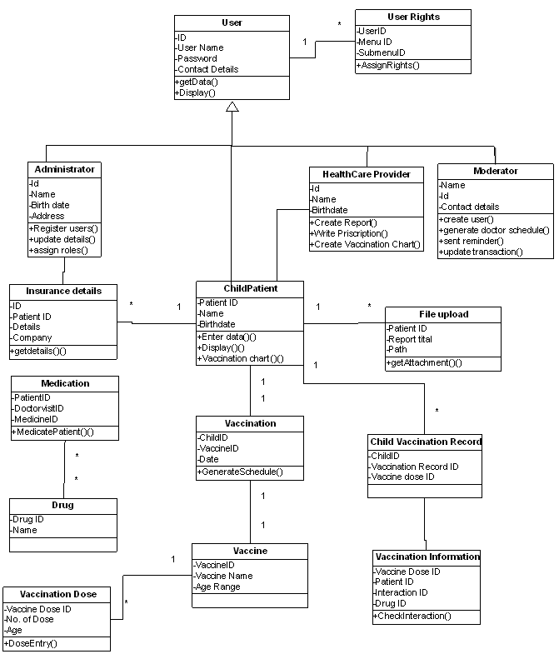
(2) Class Diagram

Slide 34
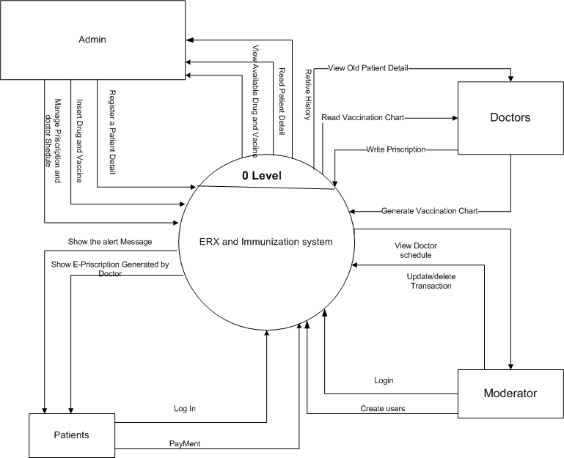
(3) Context Diagram

Slide 35
(4) 0-Level Data Flow Diagram

Slide 36
(5) 1-Level Data Flow Diagram

Slide 37
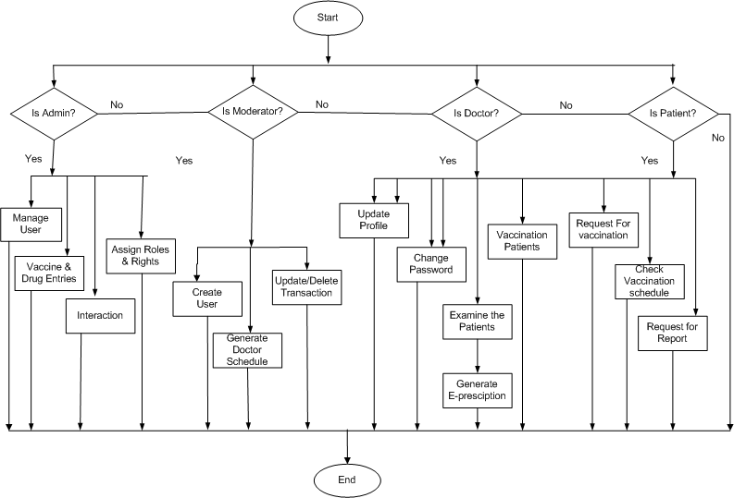
(6) Control Flow Diagram

Slide 38
(7) TABLE RELATIONSHIP AND DIAGRAM

Slide 39
(8) Flow Chart
LogIn

Slide 40
Vaccination

Slide 41
Medication

Slide 42
(9) State Transition Diagram

Slide 43
SCREEN
LAYOUT
OF
ONLINE
LIBRARY

Slide 44
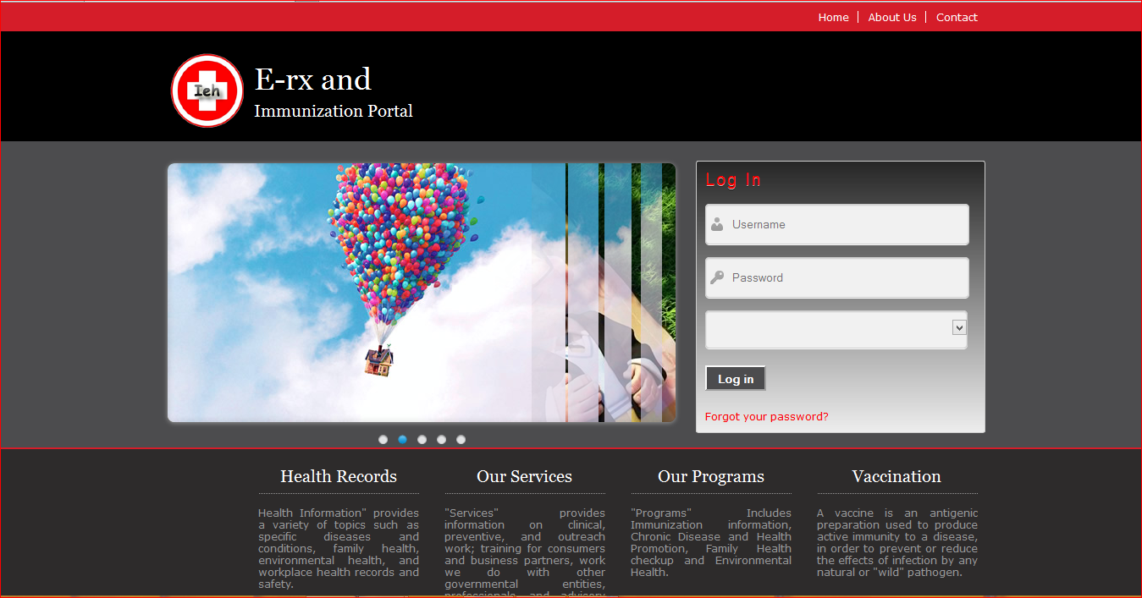
Log In Page

Slide 45
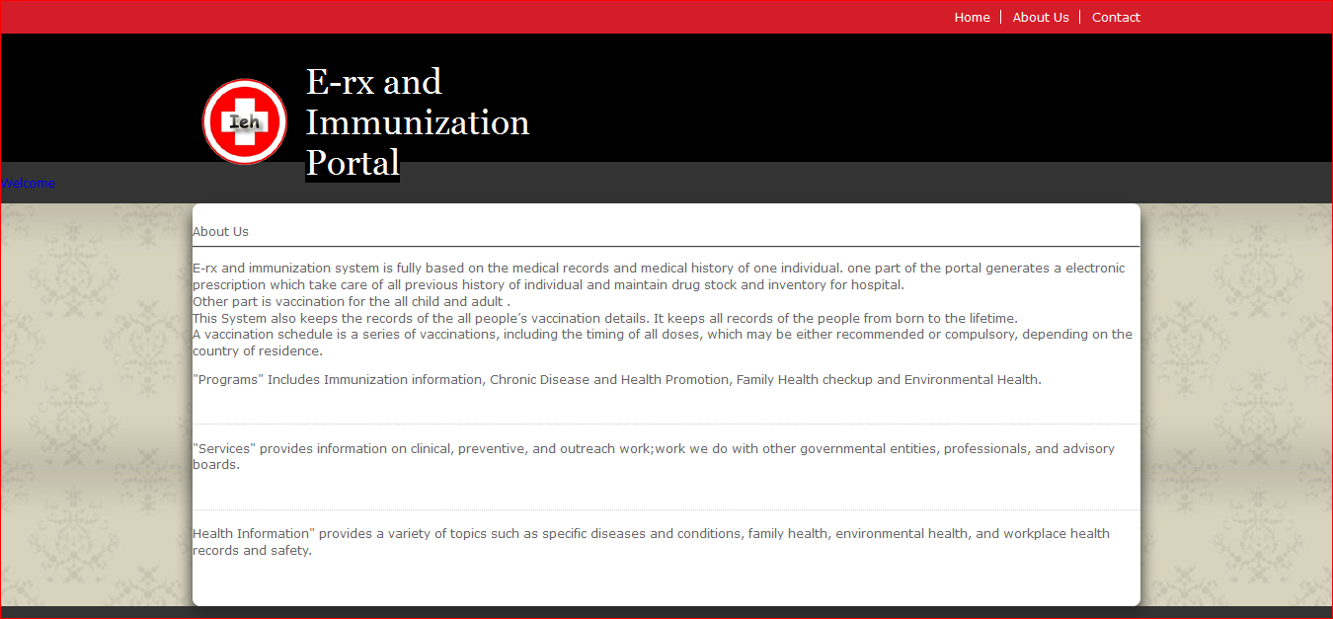
About Hospital Info Page

Slide 46
Registration Page

Slide 47
Vaccine Detail Page

Slide 48
Report Attachment Page

Slide 49
Software and Hardware Requirements
Software Requirement
Client side
Operating System Independent
Web browser(Mozila Firefox, Internet Explorer etc.)
Internet
Server side
Front – end : J2EE,JSP,SERVLET
Back-end: My SQL Server
Internet
Web browser(Mozila Firefox, Internet Explorer etc.)

Slide 50
Hardware Requirement
Processor : Minimum Microprocessor Intel Pentium IV (2.4 GHz.).
RAM : Minimum 256MB.
Hard Disk : Minimum 8GB on system drive.
Printer : (Optional) Any type of printer.

Slide 51
Process Model
As we working on an online project and we have a time of 1 year, we are using the spiral- model so that necessary services can be added with time and necessary changes can be applied.
Spiral Model
The spiral model is a software development process combining elements of both design and prototyping-in-stages, in an effort to combine advantages of top-down and bottom-up concepts.
Also known as the spiral lifecycle model (or spiral development), it is a systems development method (SDM) used in information technology (IT).
This model of development combines the features of the prototyping and the waterfall model.
The spiral model is intended for large, expensive and complicated projects.

Slide 52
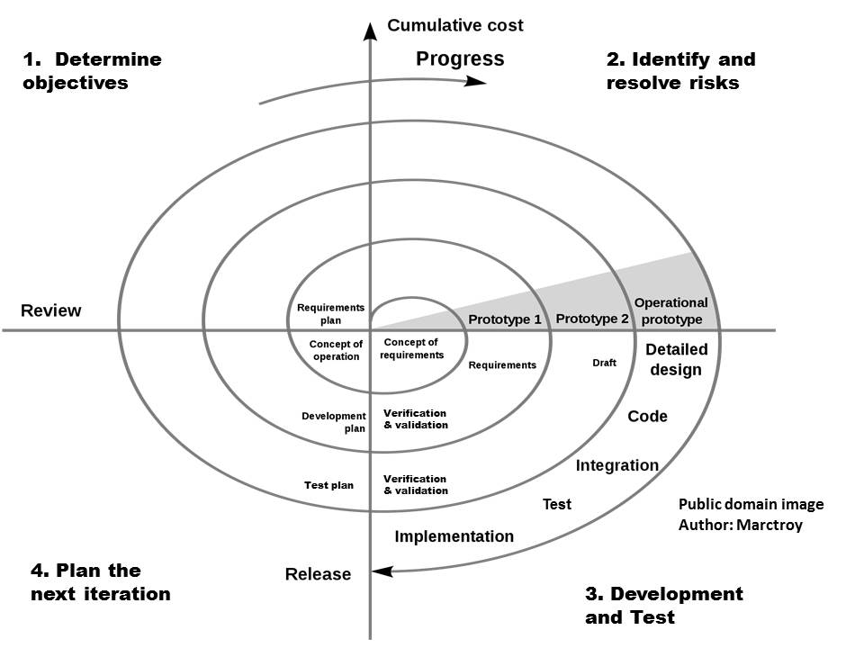
Fig :1 Spiral Model

Slide 53
Process Schedule
 |  |  | 2014 |  |  |  |  |  | 2015
ID | Task name | Duration (months) | Jul | Aug | Sep | Oct | Nov | Dec | Jan | Feb | Mar | Apr
1 | Req. Gath. | 1.5
2 | Analysis | 1.5
3 | Design | 1
4 | Coding | 3
5 | Testing | 1
6 | Deployment | 1

Slide 54
Roles and Responsibility
Responsibility | Member
Analysis | Kinjal,Bhakti.Komal
Analysis Review | Kinjal,Bhakti.Komal
Design | Bhakti,Komal
Coding | Kinjal,Bhakti
Testing | Kinjal,Komal
Documentation | Kinjal,Bhakti.Komal

Slide 55
CONCLUSION
The EIR, which must be relevant, appropriate, non-redundant, heterogeneous and enduring, possesses as a distinctive characteristic its accessibility anytime and anyplace.
E-rx and immunization system is fully based on the medical records and medical history of one individual. One part of the portal generates a electronic prescription which take care of all previous history of individual and maintain drug stock and inventory for hospital. Other part is vaccination for the all child and adult . It keeps the records of the all people’s vaccination details. It keeps all records of the people from born to the lifetime. A vaccination schedule is a series of vaccinations, including the timing of all doses, which may be either recommended or compulsory, depending on the country of residence.

Slide 56
REFERENCES
Books:
[1] Software Engineering – Ian Sommerville
[2] James Rambaugh-“Object Oriented Modeling and Design”
[3] Database Designing - Pearson
Websites:
[1] http://www.stackoverflow.com/
[2] http://www.codeproject.com/
[3] http://www.jkinfoline.com/

Slide 57
Thank
You

